Slide 1
Computer Science II Advanced C++
Spring 2018

Slide 2
Classes in C++
Class Constructors
Arrays of Objects
Unified Modeling Language (UML)
Friend Functions and Friend Classes

Slide 3
Useful Links to C++ tutorial
There are some useful hints and illustrations on classes in C++ at
http://www.cplusplus.com/doc/tutorial/classes/
on friendship and inheritance
http://www.cplusplus.com/doc/tutorial/inheritance/
and on polymorphism
http://www.cplusplus.com/doc/tutorial/polymorphism/

Slide 4
Constructors
Member function that is automatically called when an object is created
Purpose is to construct an object
Constructor function name is class name
Has no return type

Slide 5
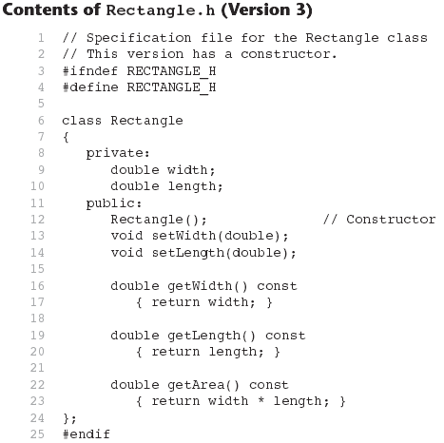

Slide 6
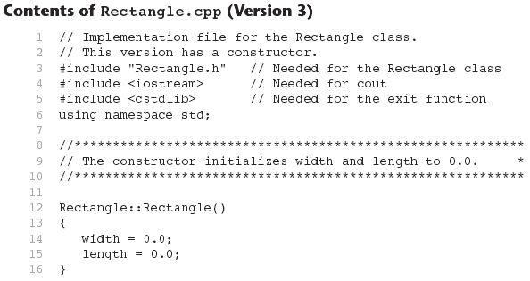
Continues...

Slide 7
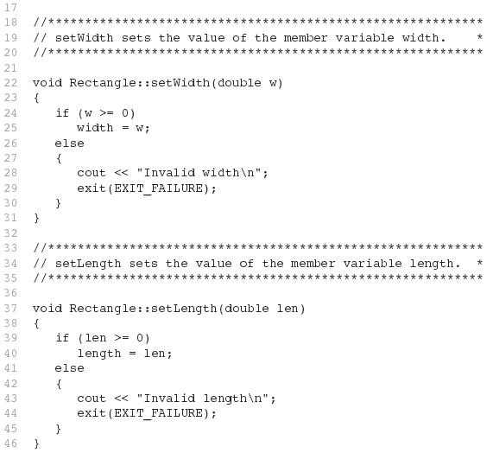
Contents of Rectangle.ccp Version3
(continued)

Slide 8
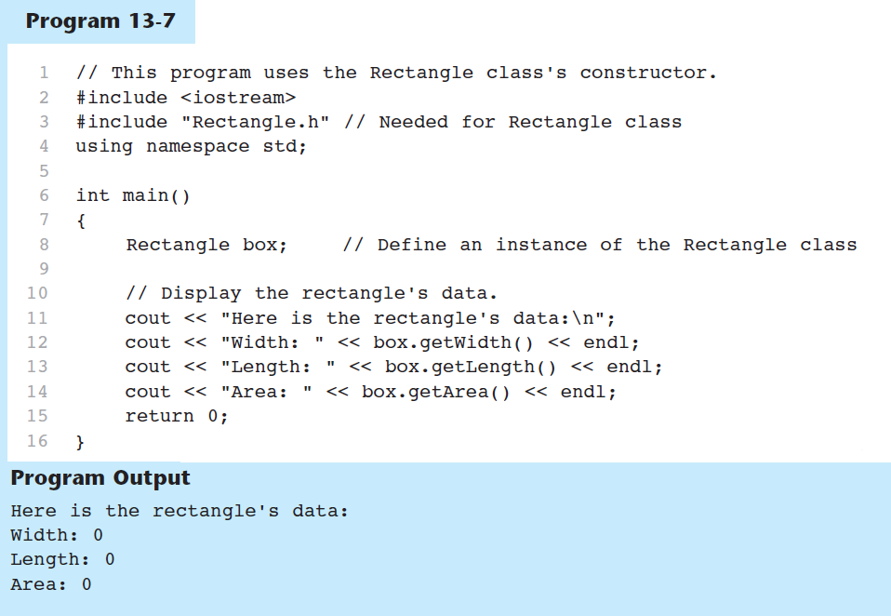

Slide 9
In-Place Initialization
If you are using C++11 or later, you can initialize a member variable in its declaration statement, just as you can with a regular variable.
This is known as in-place initialization. Here is an example:
class Rectangle
{
private:
double width = 0.0;
double length = 0.0;
public:
Public member functions appear here…
};

Slide 10
Default Constructors
A default constructor is a constructor that takes no arguments.
If you write a class with no constructor at all, C++ will write a default constructor for you, one that does nothing.
A simple instantiation of a class (with no arguments) calls the default constructor:
Rectangle r;

Slide 11
Passing Arguments to Constructors
To create a constructor that takes arguments:
indicate parameters in prototype: Rectangle(double, double);
Use parameters in the definition: Rectangle::Rectangle(double w, double len) { width = w; length = len; }

Slide 12
Passing Arguments to Constructors
You can pass arguments to the constructor when you create an object:
Rectangle r(10, 5);

Slide 13
More About Default Constructors
If all of a constructor's parameters have default arguments, then it is a default constructor. For example:
Rectangle(double = 0, double = 0);
Creating an object and passing no arguments will cause this constructor to execute: Rectangle r;

Slide 14
Classes with No Default Constructor
When all of a class's constructors require arguments, then the class has NO default constructor.
When this is the case, you must pass the required arguments to the constructor when creating an object.

Slide 15
Destructors
Member function automatically called when an object is destroyed
Destructor name is ~classname, e.g., ~Rectangle
Has no return type; takes no arguments
Only one destructor per class, i.e., it cannot be overloaded
If constructor allocates dynamic memory, destructor should release it

Slide 16
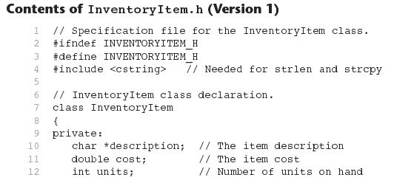

Slide 17
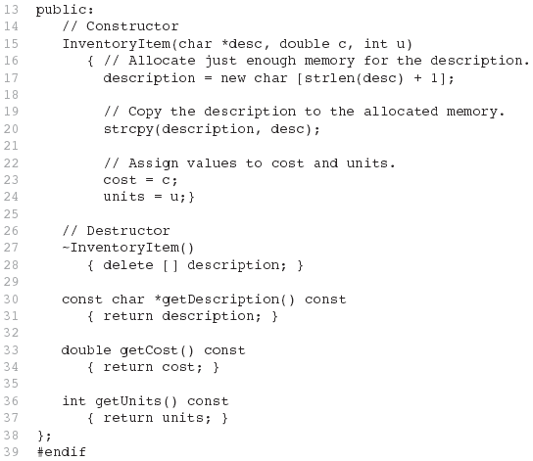
Contents of InventoryItem.h Version1
(continued)

Slide 18
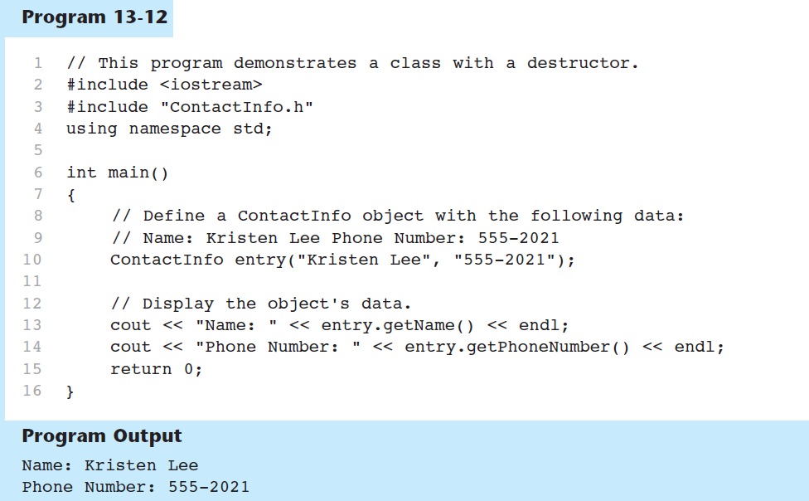

Slide 19
Constructors, Destructors, and Dynamically Allocated Objects
When an object is dynamically allocated with the new operator, its constructor executes: Rectangle *r = new Rectangle(10, 20);
When the object is destroyed, its destructor executes: delete r;

Slide 20
Overloading Constructors
A class can have more than one constructor
Overloaded constructors in a class must have different parameter lists:
Rectangle(); Rectangle(double);
Rectangle(double, double);

Slide 21
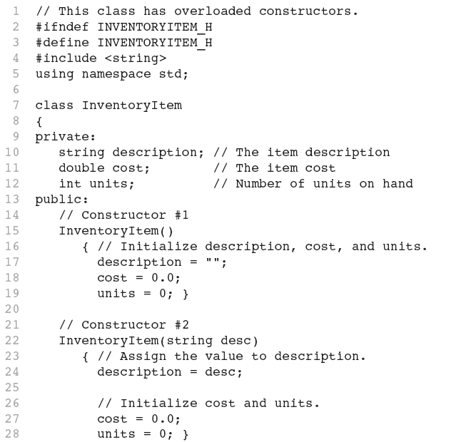
Continues...

Slide 22
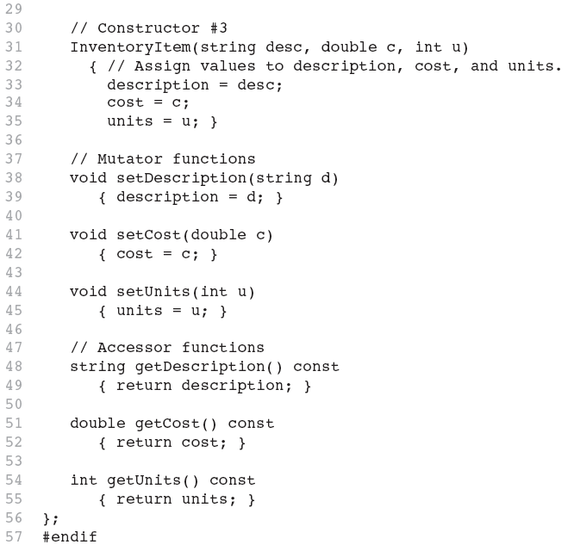

Slide 23
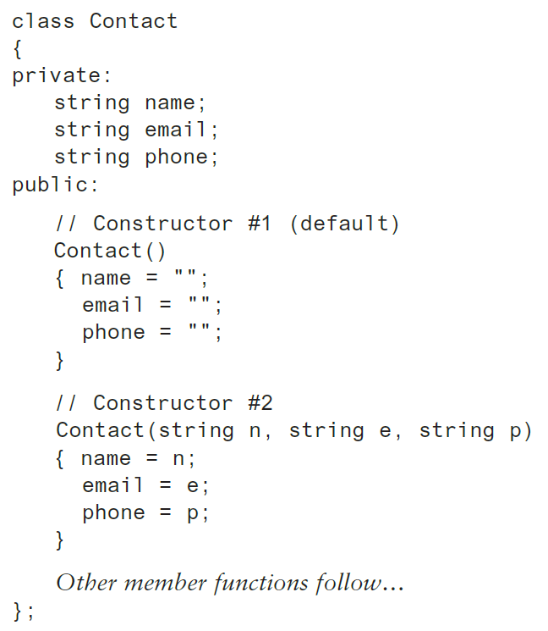
Constructor Delegation
Sometimes a class will have multiple constructors that perform a similar set of steps. For example, look at the following Contact class:

Slide 24
Constructor Delegation
Both constructors perform a similar operation: They assign values to the name, email, and phone member variables.
The default constructor assigns empty strings to the members, and the parameterized constructor assigns specified values to the members.

Slide 25
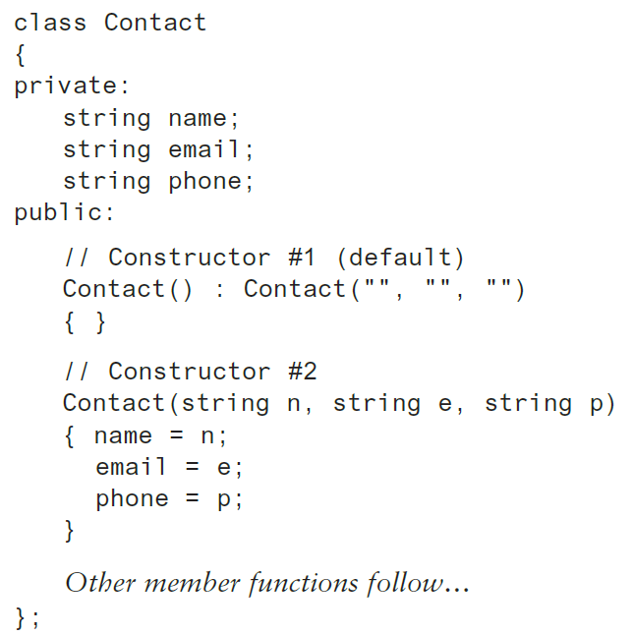
Constructor Delegation
In C++ 11, it is possible for one constructor to call another constructor in the same class.
This is known as constructor delegation.

Slide 26
Only One Default Constructor and One Destructor
Do not provide more than one default constructor for a class: one that takes no arguments and one that has default arguments for all parameters
Square();
Square(int = 0); // will not compile
Since a destructor takes no arguments, there can only be one destructor for a class

Slide 27
Member Function Overloading
Non-constructor member functions can also be overloaded:
void setCost(double);
void setCost(char *);
Must have unique parameter lists as for constructors

Slide 28
Using Private Member Functions
A private member function can only be called by another member function
It is used for internal processing by the class, not for use outside of the class
See the createDescription function in ContactInfo.h (Version 2)

Slide 29
Arrays of Objects
Objects can be the elements of an array:
InventoryItem inventory[40];
Default constructor for object is used when array is defined

Slide 30
Arrays of Objects
Must use initializer list to invoke constructor that takes arguments:
InventoryItem inventory[3] = { "Hammer", "Wrench", "Pliers" };

Slide 31

Arrays of Objects
If the constructor requires more than one argument, the initializer must take the form of a function call:

Slide 32

Arrays of Objects
It isn't necessary to call the same constructor for each object in an array:

Slide 33
Accessing Objects in an Array
Objects in an array are referenced using subscripts
Member functions are referenced using dot notation:
inventory[2].setUnits(30);
cout << inventory[2].getUnits();

Slide 34
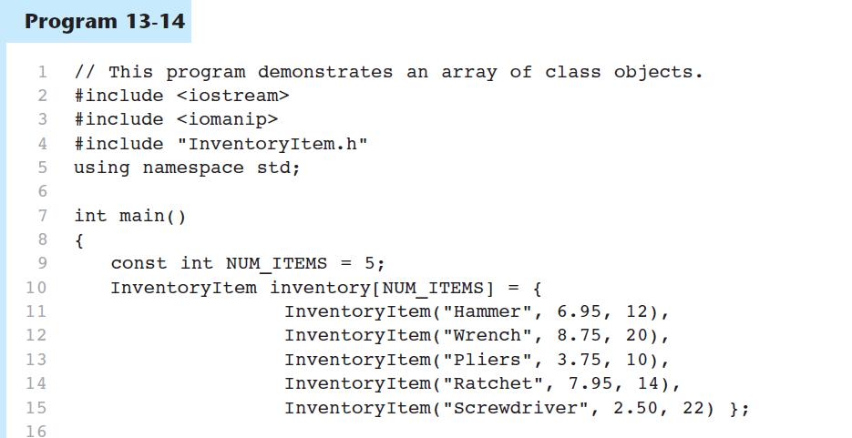

Slide 35
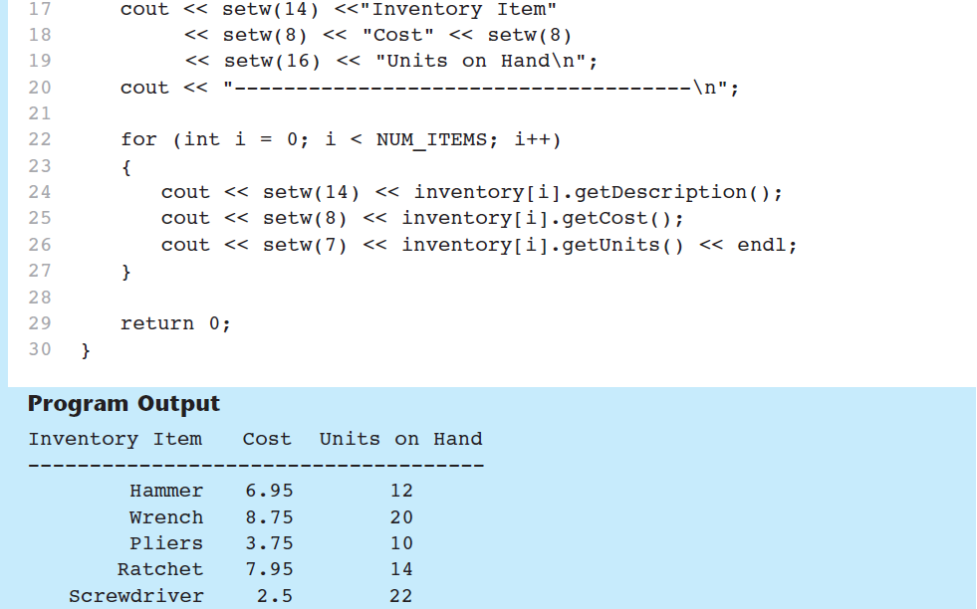
Program 13-14 (Continued)

Slide 36
The Unified Modeling Language
UML stands for Unified Modeling Language.
The UML provides a set of standard diagrams for graphically depicting object-oriented systems

Slide 37
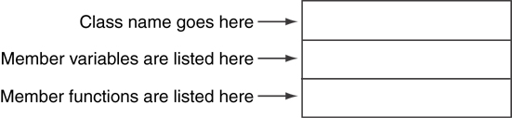
UML Class Diagram
A UML diagram for a class has three main sections.

Slide 38
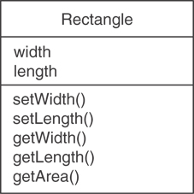
Example: A Rectangle Class
class Rectangle
{
private:
double width;
double length;
public:
bool setWidth(double);
bool setLength(double);
double getWidth() const;
double getLength() const;
double getArea() const;
};

Slide 39
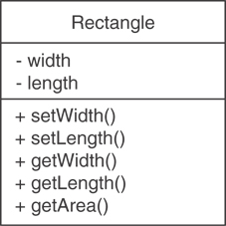
UML Access Specification Notation
In UML you indicate a private member with a minus (-) and a public member with a plus(+).
These member variables are private.
These member functions are public.

Slide 40
UML Data Type Notation
To indicate the data type of a member variable, place a colon followed by the name of the data type after the name of the variable.
- width : double
- length : double

Slide 41
UML Parameter Type Notation
To indicate the data type of a function’s parameter variable, place a colon followed by the name of the data type after the name of the variable.
+ setWidth(w : double)

Slide 42
UML Function Return Type Notation
To indicate the data type of a function’s return value, place a colon followed by the name of the data type after the function’s parameter list.
+ setWidth(w : double) : void

Slide 43
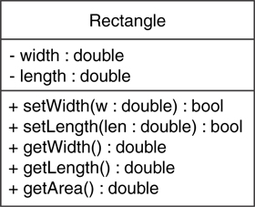
The Rectangle Class

Slide 44
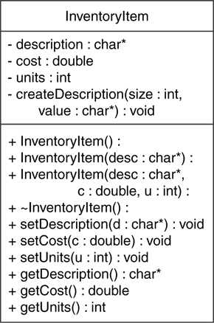
Showing Constructors and Destructors
No return type listed for constructors or destructors
Constructors
Destructor

Slide 45
Friend functions and Friend classes

Slide 46
Friend functions and classes
In principle, private and protected members of a class cannot be accessed from outside the same class in which they are declared. However, this rule does not apply to "friends"
Friends are functions or classes declared with the friend keyword
A non-member function can access the private and protected members of a class if it is declared a friend of that class
That is done by including a declaration of this external function within the class, and preceding it with the keyword friend
Typical use cases of friend functions are operations that are conducted between two different classes accessing private or protected members of both

Slide 47
friend Function Declarations
Stand-alone function:
friend void setAVal(intVal&, int);
// declares setAVal function to be
// a friend of this class
Member function of another class:
friend void SomeClass::setNum(int num)
// setNum function from SomeClass
// class is a friend of this class

Slide 48
Friend function - Example
// friend functions
#include <iostream>
using namespace std;
class Rectangle {
int width, height;
public:
Rectangle() {} // Prototype of the constructor with no parameters {} – just prototype
Rectangle (int x, int y) : width(x), height(y) {} // prototype of the constructor with 2 param.
int area() {return width * height;} // definition of function area
friend Rectangle duplicate (const Rectangle&);
};
Rectangle duplicate (const Rectangle& param) // Rectangle& means a parameter of reference
// type. This means that duplicate takes a reference of type Rectangle. Const means it cannot // be changed. Thus param contain current content of Rectangle
{
Rectangle res; // Declaration and definition of object res
res.width = param.width*2;
res.height = param.height*2;
return res;
}
int main () {
Rectangle foo;
Rectangle bar (2,3);
foo = duplicate (bar);
cout << foo.area() << '\n';
return 0;
}
The duplicate function is a friend of class Rectangle. Therefore, the duplicate function is able to access the members width and height (which are private) of different objects of type Rectangle
Notice though that neither in the declaration of duplicate nor in its later use in main, function duplicate is considered a member of class Rectangle
It isn't! It simply has access to its private and protected members without being a member

Slide 49
Friend classes
Similar to friend functions, a friend class is a class whose members have access to the private or protected members of another class

Slide 50
friend Class Declarations
Class as a friend of a class:
class FriendClass
{
...
};
class NewClass
{
public:
friend class FriendClass; // declares
// entire class FriendClass as a friend
// of this class
…
};

Slide 51
Friend classes
// definition of function convert out of its class
void Rectangle::convert (Square a) {
width = a.side;
height = a.side;
}
int main () {
Rectangle rect; // object rect
Square sqr (4); // object sqr with side=4
rect.convert(sqr); // creates width and height
cout << rect.area();
return 0;
}
// friend class
#include <iostream>
using namespace std;
class Square; // “prototype” – Square is declared here,
// but determined in detail later
class Rectangle {
int width, height;
public:
int area () // function returning area
{return (width * height);}
void convert (Square a); // prototype of function convert
};
// definition of the Square class
class Square {
friend class Rectangle; // Square is a friend of Rectangle
private:
int side;
public:
Square (int a) : side(a) {} // : is used to initialize a private member
};
In this example, class Rectangle is a friend of class Square allowing Rectangle's member functions to access private and protected members of Square
More concretely, Rectangle accesses the member variable Square ::side, which describes the side of the square.

Slide 52
The use of : in classes/constructors
It is used as, for example, here
Square (int a) : side(a) {}
Initializing member variables using initialization list before the body of the constructor executes.
A more efficient way of writing
Square (int a)
{
side = a;
}

Slide 53
Friendship as a relation
Friendships are not symmetric unless explicitly specified: In our last example, Rectangle is considered a friend class by Square, but Square is not considered a friend by Rectangle. Therefore, the member functions of Rectangle can access the protected and private members of Square but not the other way around. Of course, Square could also be declared friend of Rectangle, if needed, granting such an access
Friendships also are not transitive: The friend of a friend is not considered a friend unless explicitly specified

